Slide 1
Karnaugh Maps
John F. Wakerly – Digital Design. 4th edition. Chapter 4.
The minimization method using Boolean Algebra, apart from being laborious and requiring the remembering all the laws, can lead to solutions which, though they appear minimal, are not.
The Karnaugh map provides a simple and straightforward method of minimizing Boolean expressions.
With the Karnaugh map Boolean expressions having up to four and even six variables can be simplified.

Slide 2
What is Karnaugh Map ?
A Karnaugh map is a graphical representation of a logic function’s truth table.
The Karnaugh map is a special comfortable arrangement of a truth table.
A Karnaugh map provides a pictorial method of grouping together expressions with common factors and therefore eliminating unwanted variables.

Slide 3
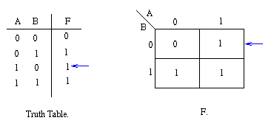
2nd order Karnaugh map example
The values inside the squares are copied from the output column of the truth table
Therefore there is one square in the map for every row in the truth table.

Slide 4
Minterms on the map
If we speak in minterm language then the Karnaugh map includes the minterms in this order.
 | A’ | A
B’ | m0 00 | m2 10
B | m1 01 | m3 11

Slide 5
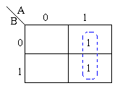
Example
The two adjacent 1's are grouped together.
The variable B has its true and false form within the group.
This eliminates variable B
leaving only variable A which only has its true form.
So Z depends only on A not B.
The minimized answer therefore is Z = A.
Adjacent Cells are grouped by function’s “1” value.

Slide 6
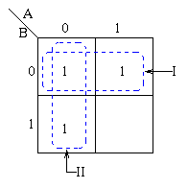
Example 2
Pairs of 1's are grouped and the simplified answer is obtained by using the following steps:
With 2 variables the largest rectangular clusters that can be made, consist of two 1s.
A 1 can belong to more than one group.
The first group labeled I, consists of two 1s which correspond to A = 0, B = 0 and A = 1, B = 0.
So the value B=0 (B’- Not B) defines this rectangle completely. The value of “A” is not important in this case because independent of the A’s value Z is always 1 when B=0.

Slide 7
Example 2
The group labeled II corresponds to the area of the map where A = 0.
The group can therefore be defined as A’
This implies that when A = 0 the output is 1 independent of B
The output is therefore 1 whenever B = 0 or A = 0

Slide 8
Third order Karnaugh map
To deal with 3 variables we need to use third order Karnaugh map.
The leftmost and rightmost columns’ cells are adjacent cells so can be grouped.

Slide 9
3rd order map example
Let’s create the Karnaugh map directly from the truth table.
A B C 0 0 0 0 0 1 0 1 0 0 1 1 1 0 0 1 0 1 1 1 0 1 1 1 | Z (A,B,C) 0 1 0 0 1 1 1 1
we have two groups of adjacent cells
and the following minimized expression:
Z = C B’+ A

Slide 10
3rd order map example (formula)
A B C 0 0 0 0 0 1 0 1 0 0 1 1 1 0 0 1 0 1 1 1 0 1 1 1 | Z (A,B,C) 0 1 0 0 1 1 1 1
Z = A’B’C + AB’C’ +AB’C + ABC’ + ABC =
A’B’C + AB’(C’ +C) + AB(C’ + C) =
A’B’C + AB’ +AB =
A’B’C + A(B’+B) =
A’B’C + A =
CB’+A

Slide 11
3rd order map another example
A B C 0 0 0 0 0 1 0 1 0 0 1 1 1 0 0 1 0 1 1 1 0 1 1 1 | Z (A,B,C) 1 0 0 0 1 1 1 1
Appropriate to the map we have the following minimized expression:
Z = C’ B’+ A

Slide 12
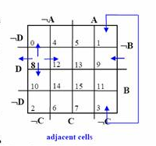
4th order Karnaugh Map

Slide 13
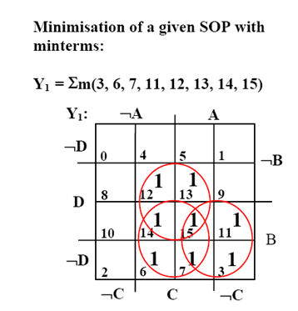
4th order Karnaugh Map
D C B A 0 0 0 0 0 0 0 1 0 0 1 0 0 0 1 1 0 1 0 0 0 1 0 1 0 1 1 0 0 1 1 1 1 0 0 0 1 0 0 1 1 0 1 0 1 0 1 1 1 1 0 0 1 1 0 1 1 1 1 0 1 1 1 1 | Z(D,C,B,A) 0 0 0 1 0 0 1 1 0 0 0 1 1 1 1 1
Y1 = CD + CB + BA

